Slide 1


CS-2001 Data Structures Fall 2022 Binary Tree and Tree ADT
Mr. Muhammad Usman Joyia
National University of Computer and Emerging Sciences,
Faisalabad, Pakistan.

Slide 2
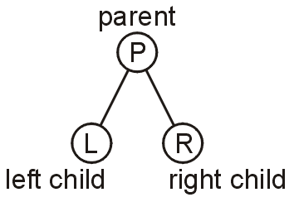
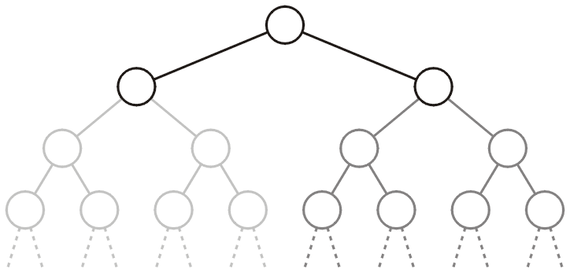
Binary Tree
In a binary tree each node has at most two children
Allows to label the children as left and right
Likewise, the two sub-trees are referred as
Left sub-tree
Right sub-tree

Slide 3
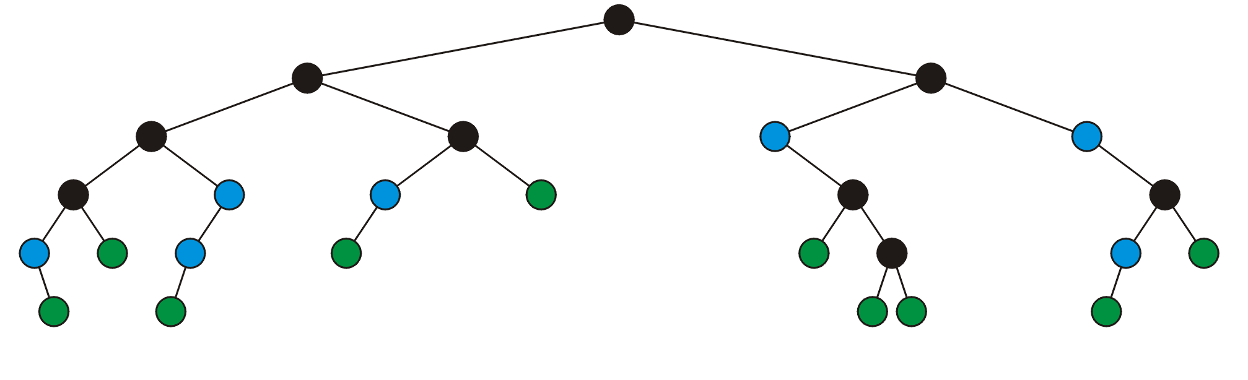
Binary Tree: Full Node
A full node is a node where both the left and right sub-trees are non-empty trees
(OR) if it has exactly two child nodes
full nodes neither leaf nodes

Slide 4
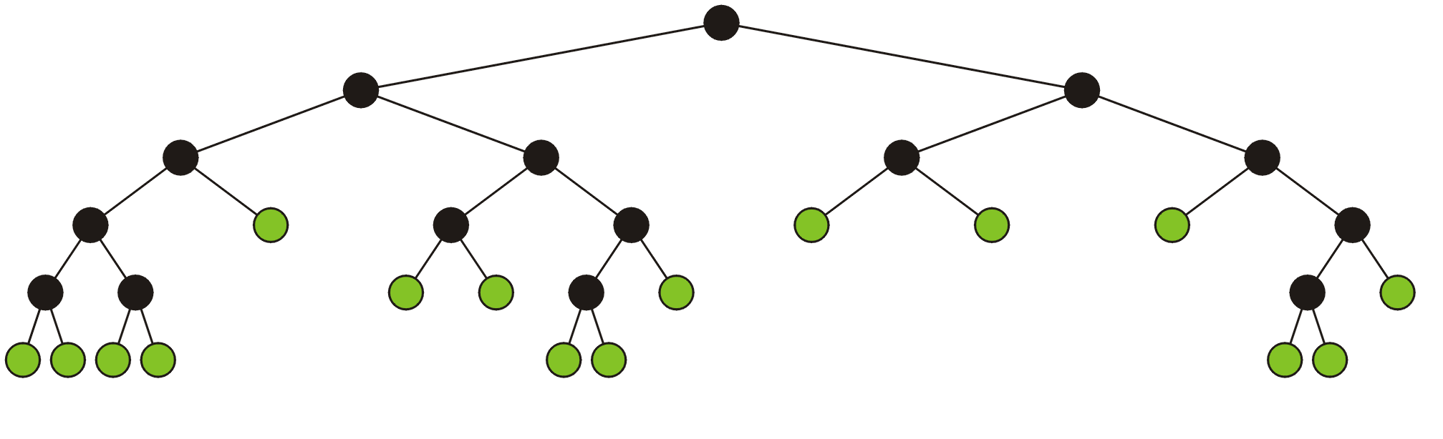
Full Binary Tree
A full binary tree is where each node is:
A full node, or
A leaf node
Full binary tree is also called proper binary tree, strictly binary tree or 2-tree

Slide 5
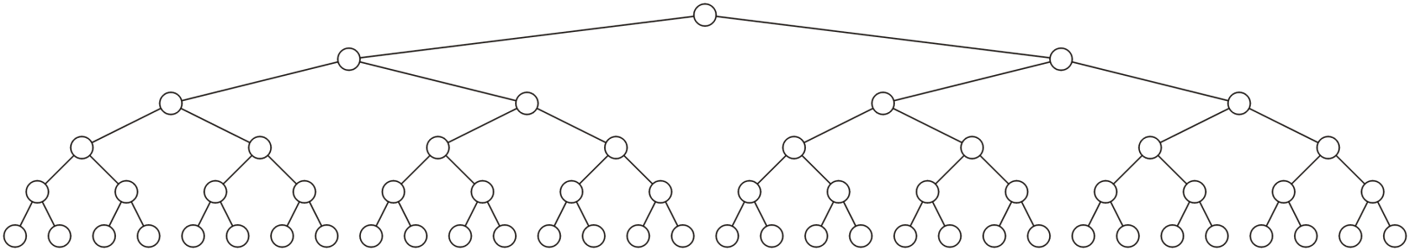
Perfect Binary Tree
A perfect binary tree of height h is a binary tree where
All leaf nodes have the same depth or level L
All other nodes are full-nodes

Slide 6
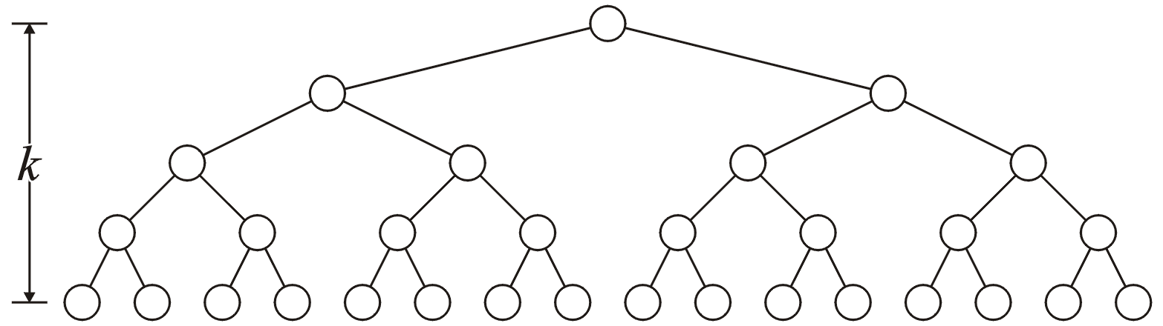
Binary Tree: Properties (3)
A perfect binary tree with height h has 2^{h} leaf nodes
A perfect binary tree of height h has 2^{h + 1} – 1 nodes
Number of leaf nodes: L = 2^{h}
Number of internal nodes: 2^{h} – 1
Total number of nodes: 2L-1 = 2^{h + 1} – 1
h

Slide 7
Binary Tree: Properties (4)
A perfect binary tree with height h has 2^{h} leaf nodes
A perfect binary tree of height h has 2^{h + 1} – 1 nodes
Number of leaf nodes: L = 2^{h}
Number of internal nodes: 2^{h} – 1
Total number of nodes: 2L-1 = 2^{h + 1} – 1
A perfect binary tree with n nodes has height log₂(n + 1) – 1

Slide 8
Binary Tree: Properties (4)
A perfect binary tree with height h has 2^{h} leaf nodes
A perfect binary tree of height h has 2^{h + 1} – 1 nodes
Number of leaf nodes: L = 2^{h}
Number of internal nodes: 2^{h} – 1
Total number of nodes: 2L-1 = 2^{h + 1} – 1
A perfect binary tree with n nodes has height log₂(n + 1) – 1
Number n of nodes in a binary tree of height h is at least h+1 and at most 2^{h + 1} – 1

Slide 9
[Almost] Complete Binary tree

Slide 10
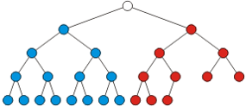
Almost (or Nearly) Complete Binary Tree
Almost complete binary tree of height h is a binary tree in which
There are 2^{d} nodes at depth d for d = 1,2,...,h−1
Each leaf in the tree is either at level h or at level h – 1
The nodes at depth h are as far left as possible
perfect binary tree of height h-1
Missing node towards the right

Slide 11
Complete Binary Tree
Complete binary tree of height h is a binary tree in which
There are 2^{d} nodes at depth d for d = 1,2,...,h−1
Each leaf in the tree is either at level h or at level h – 1
The nodes at depth h are as far left as possible (Formal ?)
Perfect binary tree of height h-1
Missing node towards the right

Slide 12
Complete Binary Tree
Condition 2: The nodes at depth h are as far left as possible
If a node p at depth h−1 has a left child
Every node at depth h−1 to the left of p has 2 children
If a node at depth h−1 has a right child
It also has a left child
Complete binary tree
Not a Complete binary tree
(condition 2 violated)

Slide 13
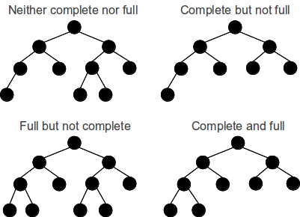
Full vs. Complete Binary Tree

Slide 14
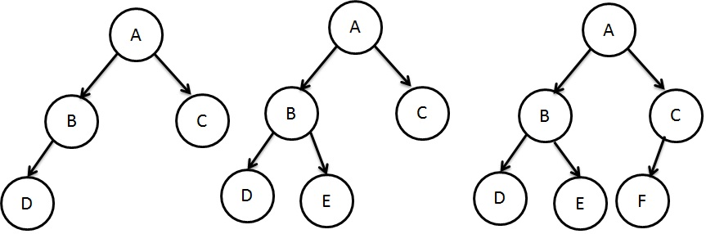
Complete Binary Trees…
What is the height and number of nodes for each tree?

Slide 15

Complete Binary Tree: Properties
Total number of nodes n are between
At least: perfect binary tree of height h-1 + 1 (i.e., 1 node in the next level) → 2^{h} – 1 + 1= 2^{h} nodes
At most: perfect binary tree of height h, i.e., 2^{h+1} -1 nodes
Height h is equal to $\left\lfloor \text{log}\text{2}\text{(}\text{n}\text{)}\right\rfloor$

Slide 16
Balanced Binary Tree
Balanced binary tree
For each node, the difference in height of the right and left sub-trees is no more than one
Both Perfect binary trees and complete binary trees are balanced as well
Completely balance binary tree
Left and right sub-trees of every node have the same height
A perfect binary tree is completely balanced
Notes:
Every complete binary tree is balanced but not the other way around.

Slide 17
Tree ADT

Slide 18
Tree ADT
Data Type: Any type of objects can be stored in a tree
Accessor methods
root() – returns the root of the tree
parent(p) – returns the parent of a node
children(p) – returns the children of a node
Query methods
size() – returns the number of nodes in the tree
isEmpty() – returns true if the tree is empty
elements() – returns all elements
isRoot(p) – returns true if node p is the root
Other methods
Tree traversal, Node addition/deletion, create/destroy

Slide 19
Binary Tree Storage
Contiguous storage
Linked-list based storage

Slide 20
Contiguous Storage

Slide 21
Array Storage Example (1)
A
[1]
[2]
[3]
[4]
[5]
[6]
[7]
[8]
[9]
A
B
C
D
E
F
G
H
I
B
C
D
E
F
G
H
I

Slide 22
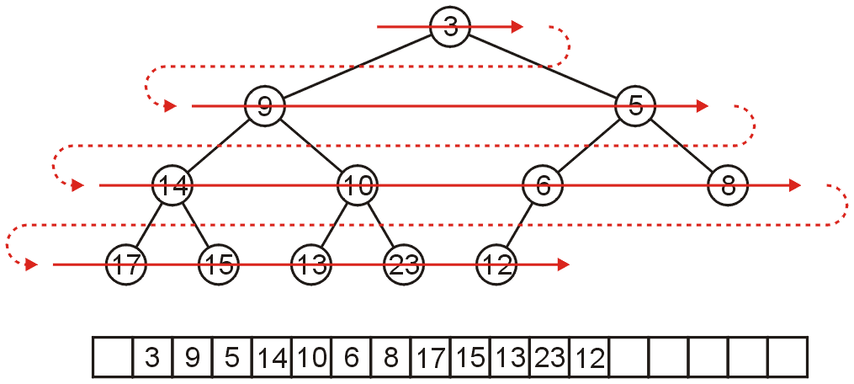
Array Storage (1)
We can store a binary tree as an array
Traverse tree in breadth-first order, placing the entries into array
Storage of elements (i.e., objects/data) starts from root node
Nodes at each level of the tree are stored left to right

Slide 23
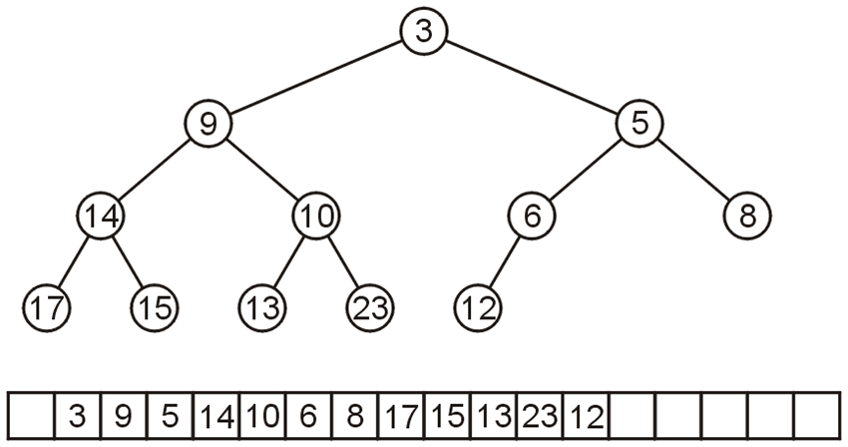
Array Storage (2)
The children of the node with index k are in 2k and 2k + 1
The parent of node with index k is in k ÷ 2
0 1 2 3 4 5 6 7 8 9 10 11 12 13 14 15 16 17

Slide 24
Array Storage Example (3)
Node 10 has index 5
Its children 13 and 23 have indices 10 and 11, respectively
0 1 2 3 4 5 6 7 8 9 10 11 12 13 14 15 16 17

Slide 25
Array Storage Example (4)
Node 10 has index 5
Its children 13 and 23 have indices 10 and 11, respectively
Its parent is node 9 with index 5/2 = 2
0 1 2 3 4 5 6 7 8 9 10 11 12 13 14 15 16 17

Slide 26
Array Storage (3)
Why array index is not started from 0
In C++, this simplifies the calculations
parent = k >> 1;
left_child = k << 1;
right_child = left_child | 1;
0 1 2 3 4 5 6 7 8 9 10 11 12 13 14 15 16 17

Slide 27
Array Storage Example (2)
Unused nodes in tree represented by a predefined bit pattern
A
[1]
[2]
[3]
[4]
[5]
[6]
[7]
[8]
[9]
…
[16]
A
B
-
C
-
-
-
D
-
…
E
B
C
D
E

Slide 28
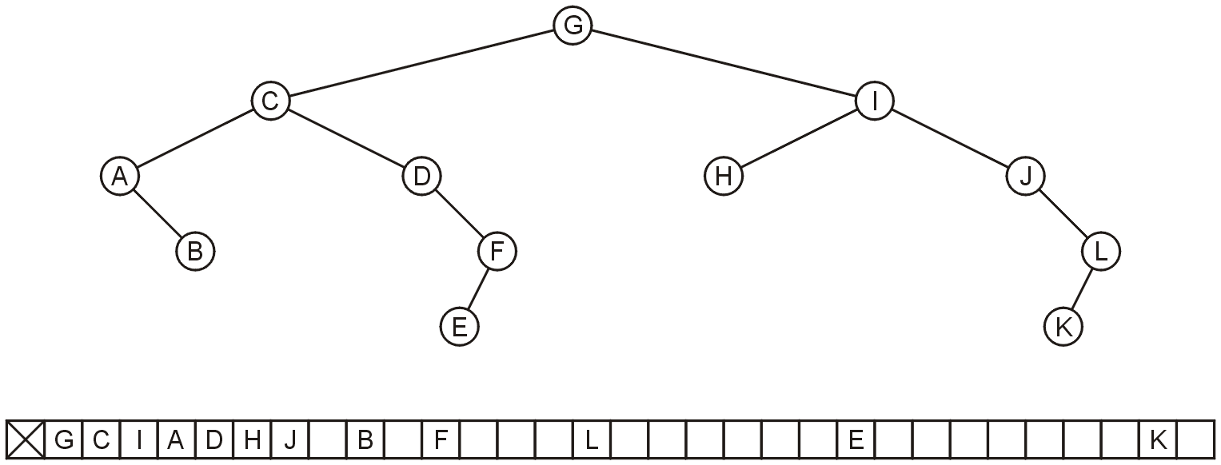
Array Storage: Disadvantage
Why not store any tree as an array using breadth-first traversals?
Because there is a significant potential for a lot of wasted memory
Consider the following tree with 12 nodes
What is the required size of array?

Slide 29
Array Storage: Disadvantage
Why not store any tree as an array using breadth-first traversals?
There is a significant potential for a lot of wasted memory
Consider the following tree with 12 nodes
What is the required size of array? 32
What will be the array size if a child is added to node K?

Slide 30
Array Storage: Disadvantage
Why not store any tree as an array using breadth-first traversals?
There is a significant potential for a lot of wasted memory
Consider the following tree with 12 nodes
What is the required size of array? 32
What will be the array size if a child is added to node K? double

Slide 31
Linked List Storage

Slide 32
As Linked List Structure (1)
We can implement a binary tree by using a struct which stores:
An element
A left child pointer (pointer to first child)
A right child pointer (pointer to second child)
The root pointer points to the root node
Follow pointers to find every other element in the tree
Leaf nodes have LeftChild and RightChild pointers set to NULL
struct Node{
Type value;
Node *LeftChild,*RightChild;
}*root;

Slide 33
As Linked List Structure: Example
Root pointer
a
b
c
d
e
f
g
h
i
j
k
l

Slide 34
Tree Traversal

Slide 35
Tree Traversal
To traverse (or walk ) the tree is to visit (printing or manipulating) each node in the tree exactly once
Traversal must start at the root node
There is a pointer to the root node of the binary tree
Two types of traversals
Breadth-First Traversal
Depth-First Traversal

Slide 36
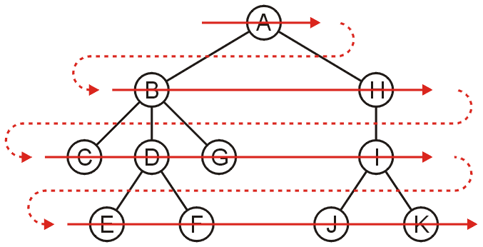
Breadth-First Traversal (For Arbitrary Trees)
All nodes at a given depth d are traversed before nodes at d+1
Can be implemented using a queue
Order: A B H C D G I E F J K

Slide 37
Breadth-First Traversal – Implementation
Create a queue and push the root node onto the queue
While the queue is not empty:
Enqueue all of its children of the front node onto the queue
Dequeue the front node

Slide 38
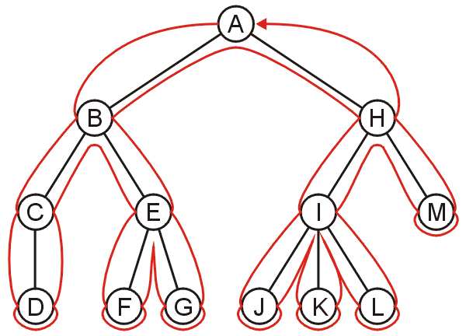
Depth-First Traversal (For Arbitrary Trees)
Traverse as much as possible along the branch of each child before going to the next sibling
Nodes along one branch of the tree are traversed before backtracking
Each node could be approached multiple times in such a scheme
The first time the node is approached (before any children)
The last time it is approached (after all children)

Slide 39
Depth-First Tree Traversal (Binary Trees)
For each node in a binary tree, there are three choices
Visit the node first
Visit the node after left subtree
Visit the node after both the subtrees
These choices lead to three commonly used traversals
Preorder traversal: visit Root (Left subtree) (Right subtree)
Inorder traversal: (Left subtree) visit Root (Right subtree)
Postorder traversal: (Left subtree) (Right subtree) visit Root

Slide 40
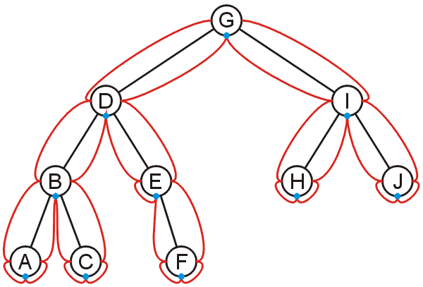
Inorder Traversal
Algorithm
Traverse the left subtree in inorder
Visit the root
Traverse the right subtree in inorder
A, B, C, D, E, F, G, H, I, J

Slide 41
Inorder Traversal
Algorithm
Traverse the left subtree in inorder
Visit the root
Traverse the right subtree in inorder
Example
Left + Right
[Left * Right] + [Left + Right]
(A * B) + [(Left * Right) + E)
(A * B) + [(C * D) + E]
+
*
+
A
B
*
E
C
D

Slide 42
Inorder Traversal – Implementation
void inorder(Node *p) const
{
if (p != NULL)
{
inorder(p->leftChild);
cout << p->info << " ";
inorder(p->rightChild);
}
}
void main () {
. . .
inorder (root);
}

Slide 43
Preorder Traversal
Algorithm
Visit the node
Traverse the left subtree
Traverse the right subtree
Example
+ Left Right
+ [ * Left Right] [+ Left Right]
+ ( * AB) [+ * Left Right E]
+*AB + *C D E
+
*
+
A
B
*
E
C
D

Slide 44
Preorder Traversal – Implementation
void preorder(Node *p) const
{
if (p != NULL)
{
cout << p->info << " ";
preorder(p->leftChild);
preorder(p->rightChild);
}
}
void main () {
. . .
preorder (root);
}

Slide 45
Postorder Traversal
Algorithm
Traverse the left subtree
Traverse the right subtree
Visit the node
Example
Left Right +
[Left Right *] [Left Right+] +
(AB*) [Left Right * E + ]+
(AB*) [C D * E + ]+
AB* C D * E + +
+
*
+
A
B
*
E
C
D

Slide 46
Postorder Traversal – Implementation
void postorder(Node *p) const
{
if (p != NULL)
{
postorder(p->leftChild);
postorder(p->rightChild);
cout << p->info << " ";
}
}
void main () {
. . .
postorder (root);
}

Slide 47
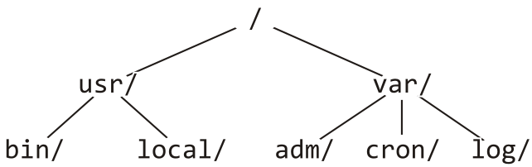
Example: Printing a Directory Hierarchy
Consider the directory structure presented on the left
Which traversal should be used?
/
usr/
bin/
local/
var/
adm/
cron/
log/

Slide 48
Any Question So Far?

